Slide 1
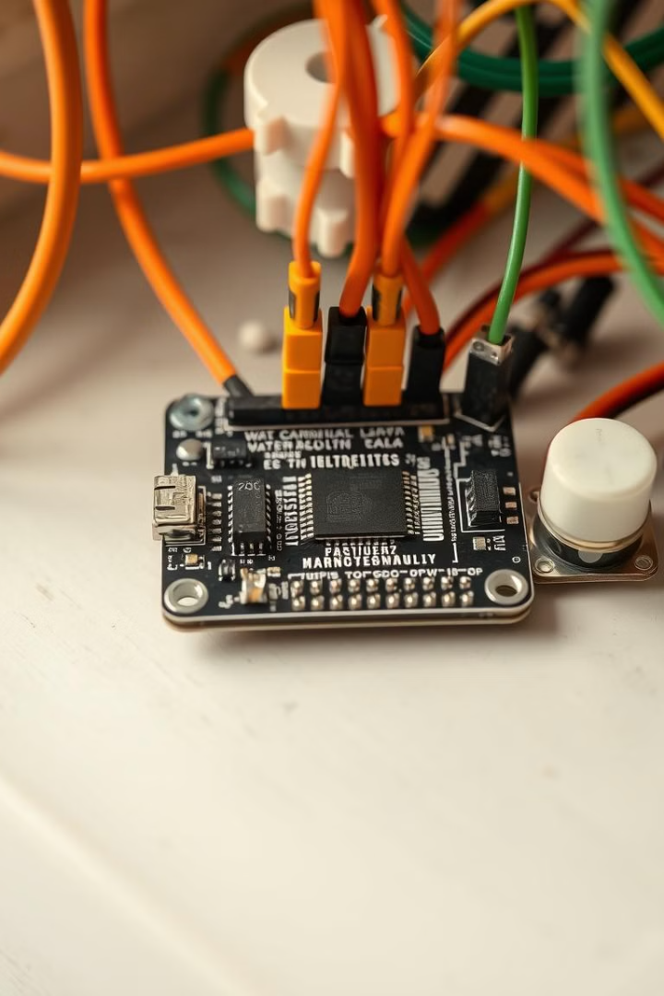
Water Quality Monitoring Using ESP32
This project focuses on building a water quality monitoring system using the ESP32 microcontroller
PRESENTED BY :
KEERTHI VELIVALA - 2320040083
ALURU DOONDI BALA SARASWATHI -2320040050
DVSNL PRAHARSHITHA – 2320040059
23SDEC01R

Slide 2
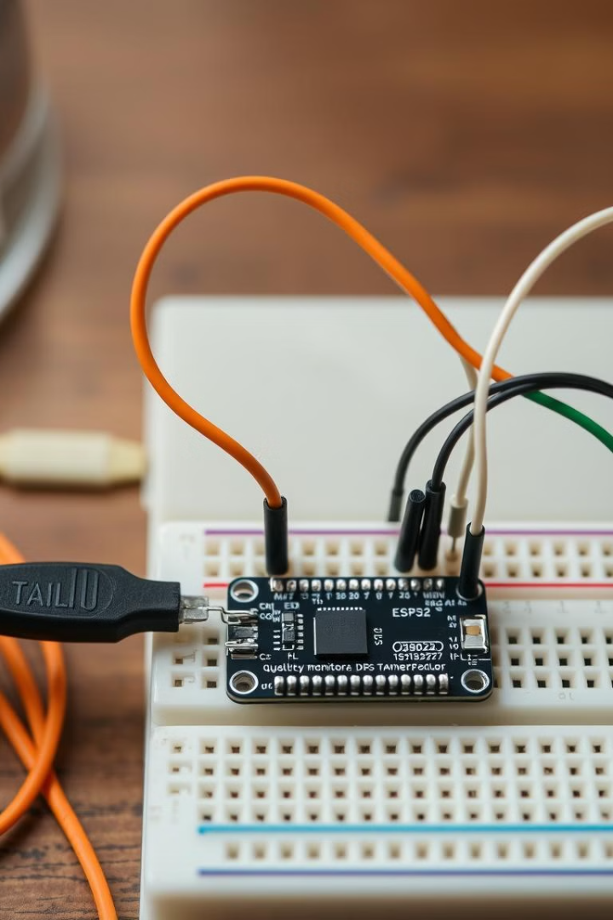
Components Used
ESP32 Board
Analog TDS Sensor
The ESP32 is a powerful microcontroller with built-in Wi-Fi and Bluetooth capabilities, making it ideal for IoT applications.
The TDS sensor measures the total dissolved solids in water, indicating the level of impurities.
DS18B20 Temperature Sensor
Resistor, Wires, Breadboard
The DS18B20 is a digital temperature sensor that utilizes the one-wire protocol for communication with the ESP32.
These components provide electrical connections and pathways for the sensor signals and power.

Slide 3
Monitoring Water Parameters
Temperature
Total Dissolved Solids (TDS)
The DS18B20 sensor provides accurate temperature readings, which are essential for understanding the water's condition.
The TDS sensor measures the concentration of dissolved salts and minerals in the water, indicating its purity.
23SDEC01R

Slide 4
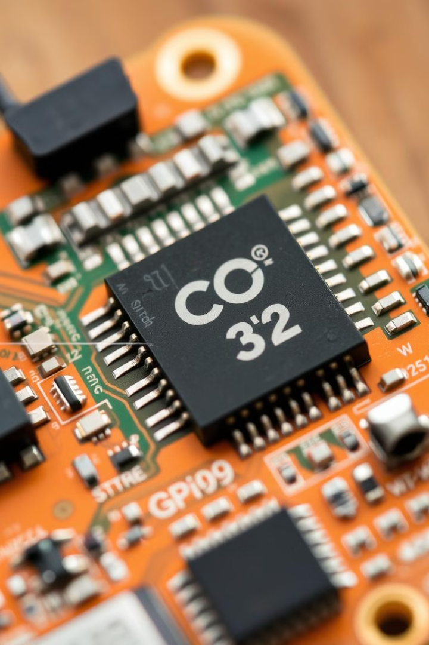
ESP32 Microcontroller: Features and Capabilities
1
Processor
2
Memory
The ESP32 has a dual-core Tensilica LX6 processor, capable of handling complex calculations and data processing.
It features ample RAM and flash memory for storing program code, data, and configuration settings.
3
Connectivity
4
GPIO Pins
The ESP32 boasts integrated Wi-Fi and Bluetooth modules, enabling wireless communication for data transmission.
The ESP32 provides a range of GPIO pins for interfacing with external sensors, actuators, and other peripherals.
23SDEC01R

Slide 5
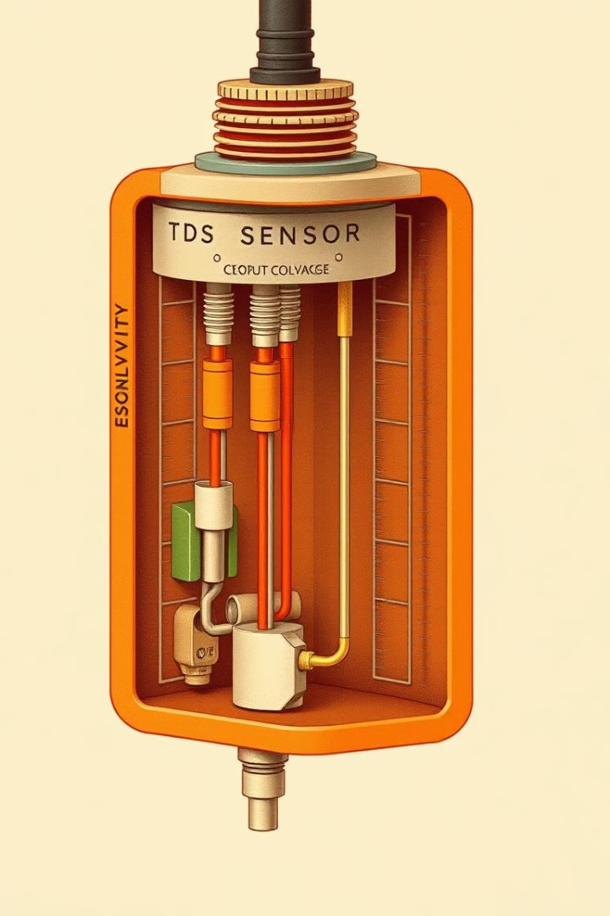



Analog TDS Sensor: Principles and Connection
Conductivity Measurement
The TDS sensor measures the conductivity of water, which is directly proportional to the TDS level.
Voltage Output
The sensor outputs a voltage signal that varies based on the conductivity of the water.
Analog-to-Digital Conversion
The ESP32's ADC converts the analog voltage signal from the sensor into a digital value.

Slide 6
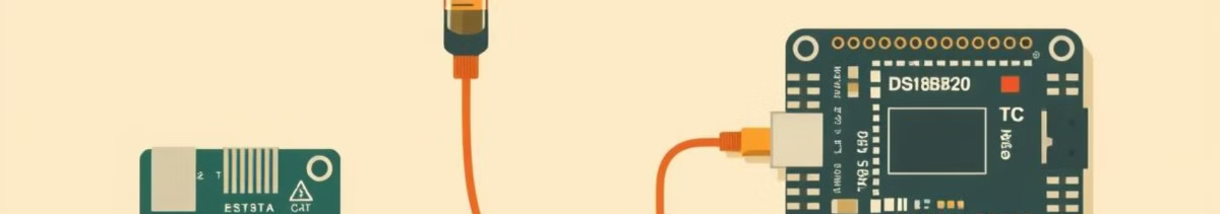
DS18B20 Temperature Sensor: One-Wire Communication
Feature
Description
One-Wire
Utilizes a single data line for communication, reducing wiring complexity.
Digital
Outputs digital temperature readings, eliminating the need for analog-to-digital conversion.
Parasitic Power
Can draw power directly from the data line, simplifying power supply requirements.
23SDEC01R

Slide 7
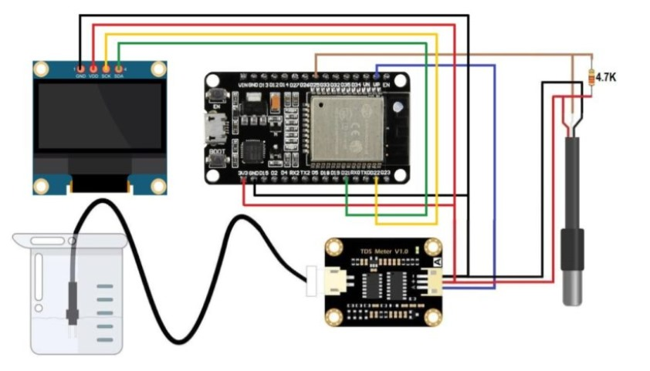
CIRCUIT DIAGRAM
23SDEC01R

Slide 8

Data Acquisition and Processing
1
2
3
4
Sensor Readings
Data Conversion
Data Filtering
Data Logging
The ESP32 reads data from the TDS and temperature sensors at regular intervals.
The sensor readings are converted into meaningful units, such as ppm for TDS and degrees Celsius for temperature.
Any noise or outliers in the sensor readings are removed to ensure data accuracy.
The processed data is stored in a log file or database for further analysis and visualization.
23SDEC01R

Slide 9
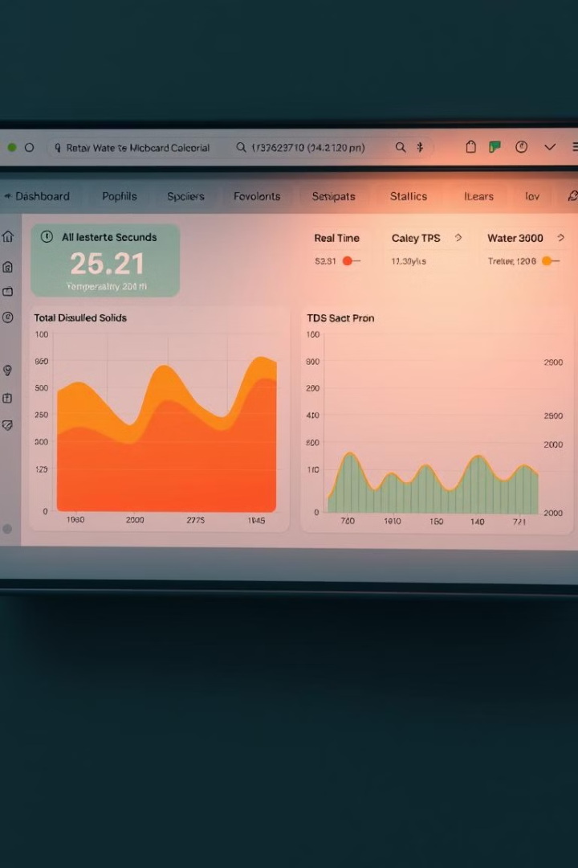



Displaying and Logging the Data
Cloud Platform
The ESP32 transmits the data to a cloud platform, such as ThingSpeak, for storage and visualization.
Data Visualization
The collected data is presented in a user-friendly dashboard with graphs, charts, and tables for easy analysis.
Alerts and Notifications
The system can send alerts and notifications to users when water quality exceeds predefined thresholds.

Slide 10
THANK YOU

